Slide 1

DEPARTMENT OF CSE (ARTIFICIAL INTELLIGENCE AND MACHINE LEARNING) ACADEMIC YEAR 2025 - 2026 SEMESTER III ARTIFICIAL INTELLIGENCE LABORATORY MINI PROJECT REVIEW RESUME RELEVANCE SYSTEM
REGISTER NUMBER
NAME | DHEEPAK S
YEAR | II
DEPARTMENT | B.E.CSE(AIML)-”A”
FACULTY IN-CHARGE | Mrs. M. Divya

Slide 2
PROBLEM STATEMENT
The problem addressed in this project is the need for an automated, accurate, and efficient system that can:
1. Evaluate resumes against a job description.
2. Quantify relevance using both keyword-based (hard) and semantic (soft) similarity.
3. Highlight missing skills and provide actionable suggestions for improvement

Slide 3
THEORETICAL BACKGROUND
Recruitment is a critical process for organizations, but manually evaluating resumes against job descriptions is often time-consuming, inconsistent, and prone to bias.
Candidates may possess varying levels of skills, and recruiters need a systematic method to objectively assess relevance.
Automating this process using Artificial Intelligence (AI) can significantly reduce human effort, improve accuracy, and provide actionable insights.

Slide 4
IMPLEMENTATION AND CODE
Link to code in Git-hub Repository
List | Git-hub Repository Links
Implementation of Code Link | https://github.com/Dheepaksuresh/resume_relevance_system
Word Document Report Link | AI MINIPROJECT.pdf
PPT Link | AI MINIPROJECT.ppt

Slide 5
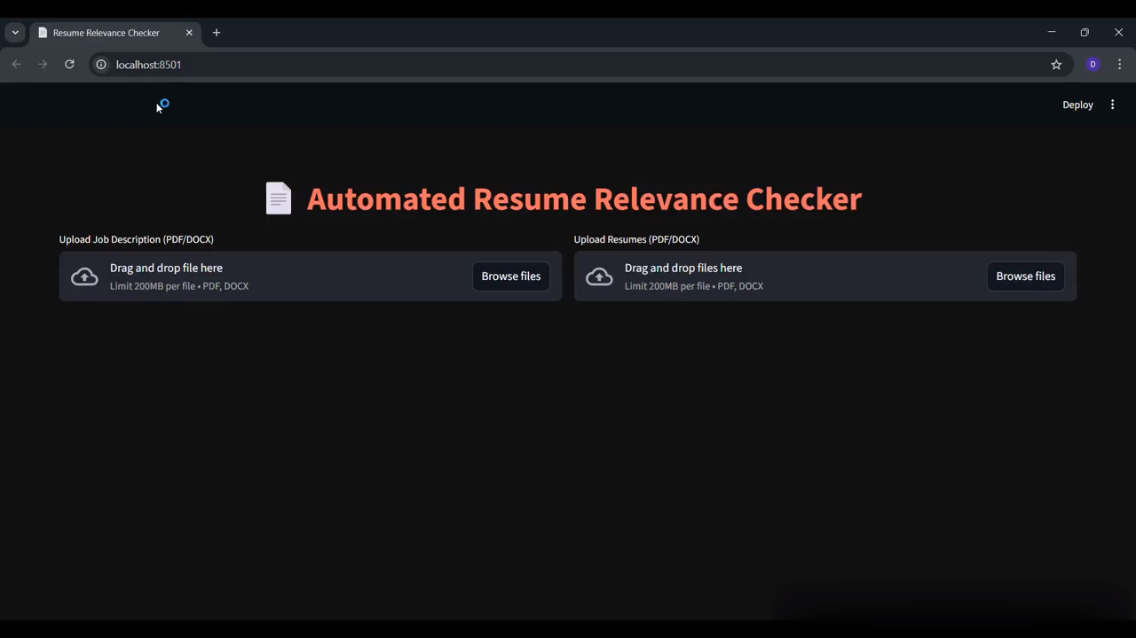
OUTPUT AND RESULTS

Slide 6
FUTURE ENHANCEMENTS
Multi-language Support – Evaluate resumes in different languages.
Experience & Certification Scoring – Include candidate experience and certifications for scoring.
Integration with ATS – Connect directly with Applicant Tracking Systems for large scale recruitment.
Advanced Semantic Models – Use larger transformer models (e.g., BERT, RoBERTa) for improved accuracy.
Skill Weighting – Allow recruiters to assign different weights to critical vs optional skills.
Dashboard Analytics – Add interactive analytics for recruiters to track trends across multiple hires.

Slide 7
REFERENCES
1. Jurafsky, D., & Martin, J. H. (2021). Speech and Language Processing (3rd ed., draft). [Online Book Draft] o https://web.stanford.edu/~jurafsky/slp3/
2. Bird, S., Klein, E., & Loper, E. (2009). Natural Language Processing with Python. O’Reilly Media.
3. Reimers, N., & Gurevych, I. (2019). Sentence-BERT: Sentence Embeddings using Siamese BERT-Networks. arXiv:1908.10084. o https://arxiv.org/abs/1908.10084
4. Géron, A. (2019). Hands-On Machine Learning with Scikit-Learn, Keras, and TensorFlow (2nd ed.). O’Reilly Media.
5. McKinney, W. (2017). Python for Data Analysis: Data Wrangling with Pandas, NumPy, and IPython (2nd ed.). O’Reilly Media.
6. Brownlee, J. (2020). Master Machine Learning Algorithms. Machine Learning Mastery. o https://machinelearningmastery.com/master-machine-learning-algorithms/

